Slide 1
AML-3303 Databases in AI and ML: Concepts, Choices and Emerging Technologies

Slide 2
Topics We Will Cover
Title
Introduction to Databases
OLTP vs OLAP
Types of Databases
Choosing the Right Database
Relational DBs in AI/ML
Introduction to Vector DBs
How Vector Databases Work
Elasticsearch and Hybrid Search
Database Architecture in AI/ML Pipelines

Slide 3
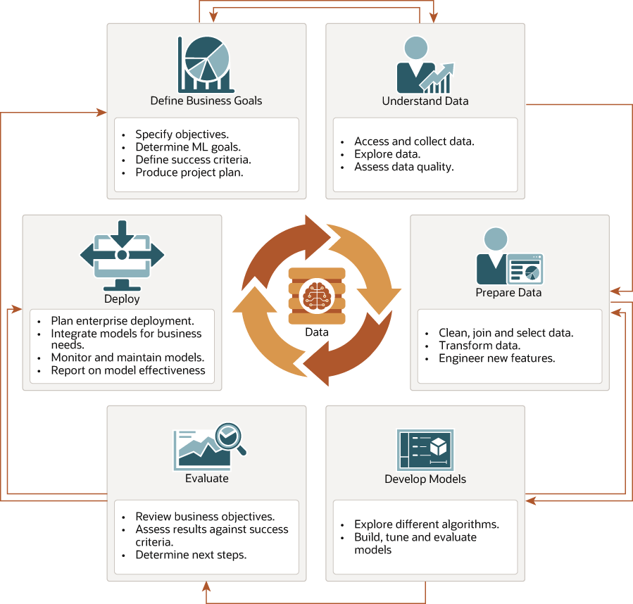
Title
In AI/ML pipelines, data is everything. Without strong storage and retrieval systems, even great models fail.

Slide 4

Introduction to Databases
A database is a system to store, organize and manage data efficiently.
They are foundational for all data-driven applications, especially AI/ML pipelines:
Data ingestion
Preprocessing
Storage for training, evaluation, and deployment
Traditional vs. modern databases:
Traditional: optimized for transactions (OLTP)
Modern: optimized for scale, unstructured data, analytics
Industry use case:
Netflix uses different databases to manage user data, logs, and streaming events across its AI recommendation pipeline.

Slide 5
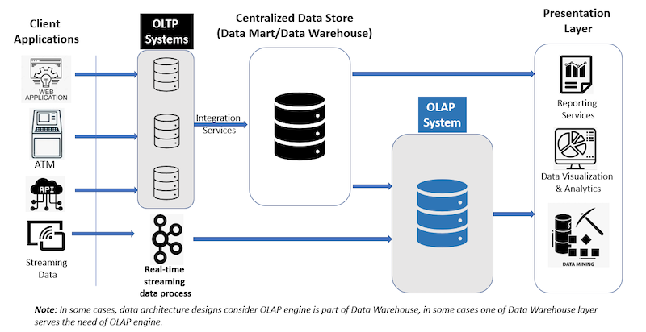

Slide 6
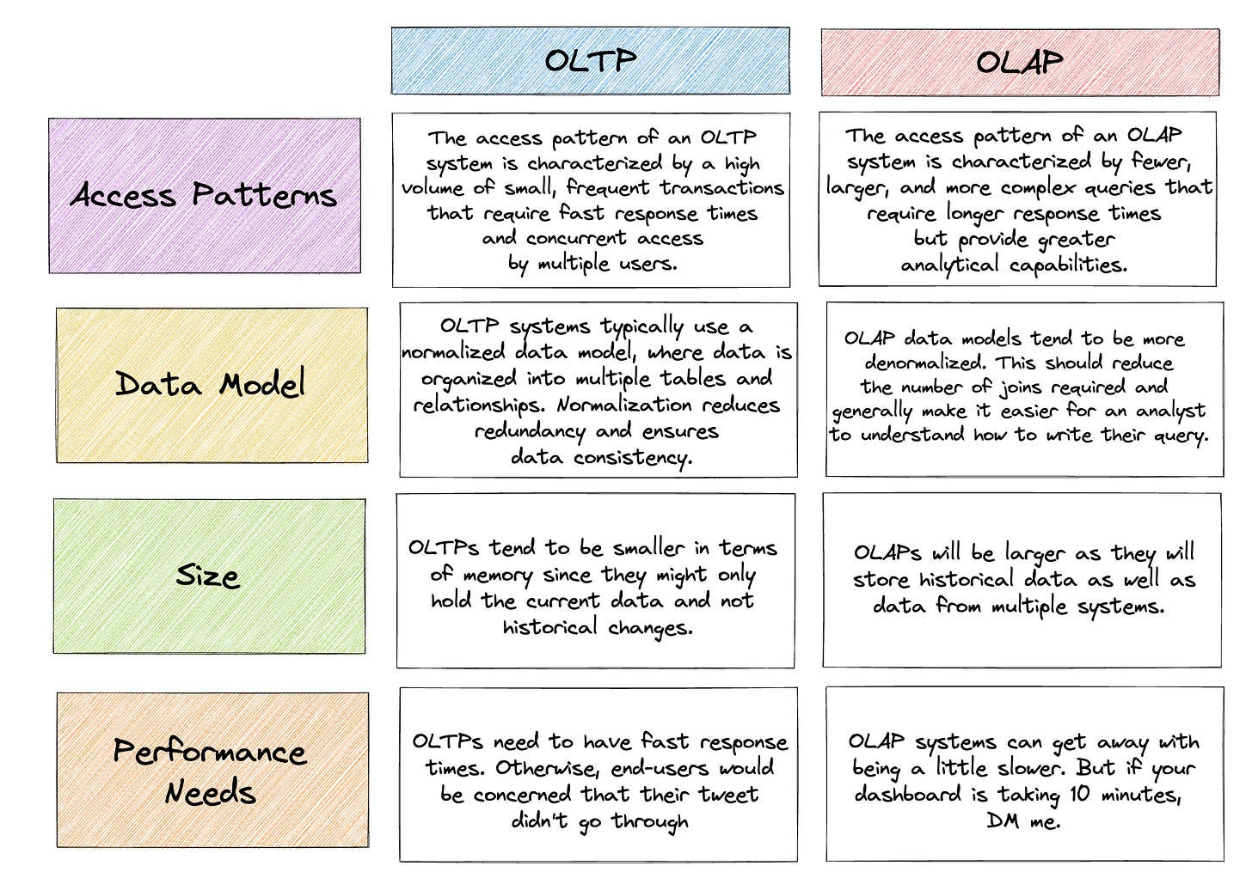

Slide 7
Types of Databases
Relational Databases (RDBMS): MySQL, PostgreSQL, Oracle
Structured data, ACID transactions, strong consistency.
NoSQL Databases: MongoDB, Cassandra, DynamoDB
Flexible schema, high scalability, good for semi/unstructured
data
In-Memory Databases: Redis, Memcached
Extremely fast data access, caching, and session management.
Graph Databases: Neo4j, Amazon Neptune
Store and query relationships between entities.
Time-Series Databases: InfluxDB, TimescaleDB
Optimized for metrics, IoT, and logs.
Vector Databases: Pinecone, Weaviate, Milvus, Vespa
Designed for similarity search on high-dimensional vectors.
Notes:
Uber: uses MySQL + Redis for trip data, MongoDB for some unstructured data, and Cassandra for scalability.
LinkedIn: uses a graph database to power “People You May Know”.

Slide 8
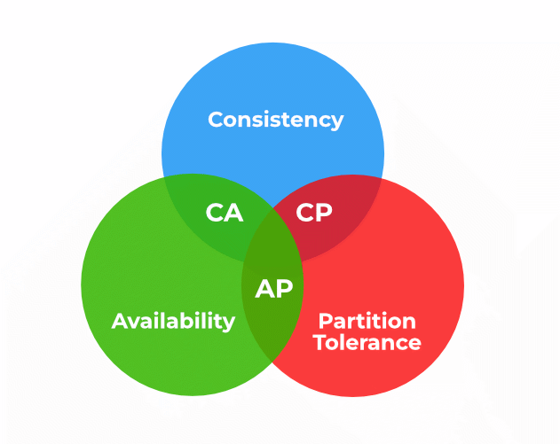
Choosing the Right Database
Understand your data:
  Structure (rows/columns vs JSON vs embeddings)
  Volume (GB vs TB vs PB)
  Velocity (batch vs streaming)
Query patterns: transactional vs analytical
Scalability and performance requirements
Data consistency vs availability (CAP theorem)
Integration with AI/ML pipelines (ETL, feature stores)
Cost and vendor lock-in considerations
Notes:
Spotify uses PostgreSQL for user accounts, Cassandra for streaming metrics, and Google Bigtable for analytics.

Slide 9
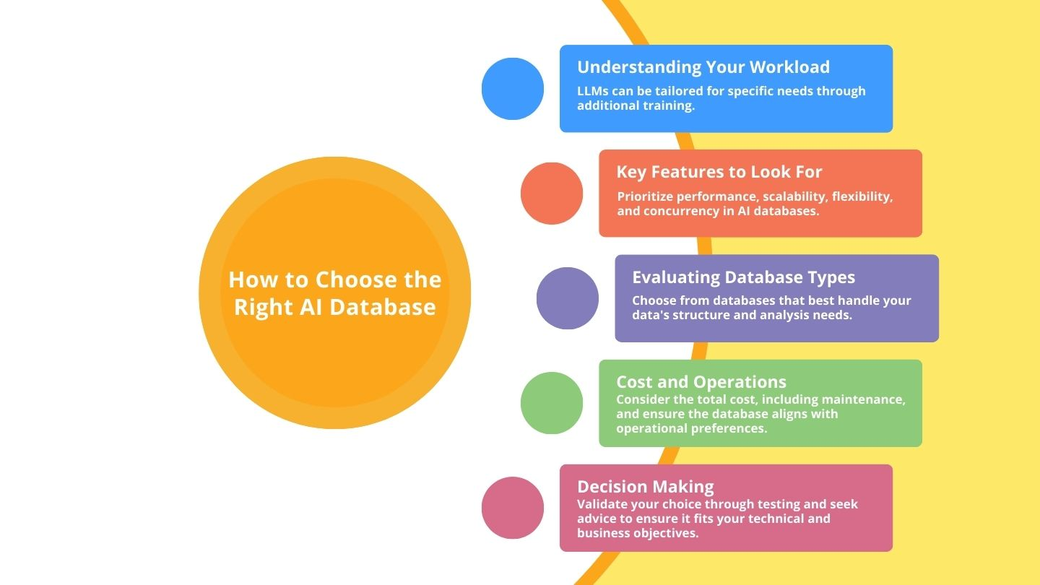

Slide 10
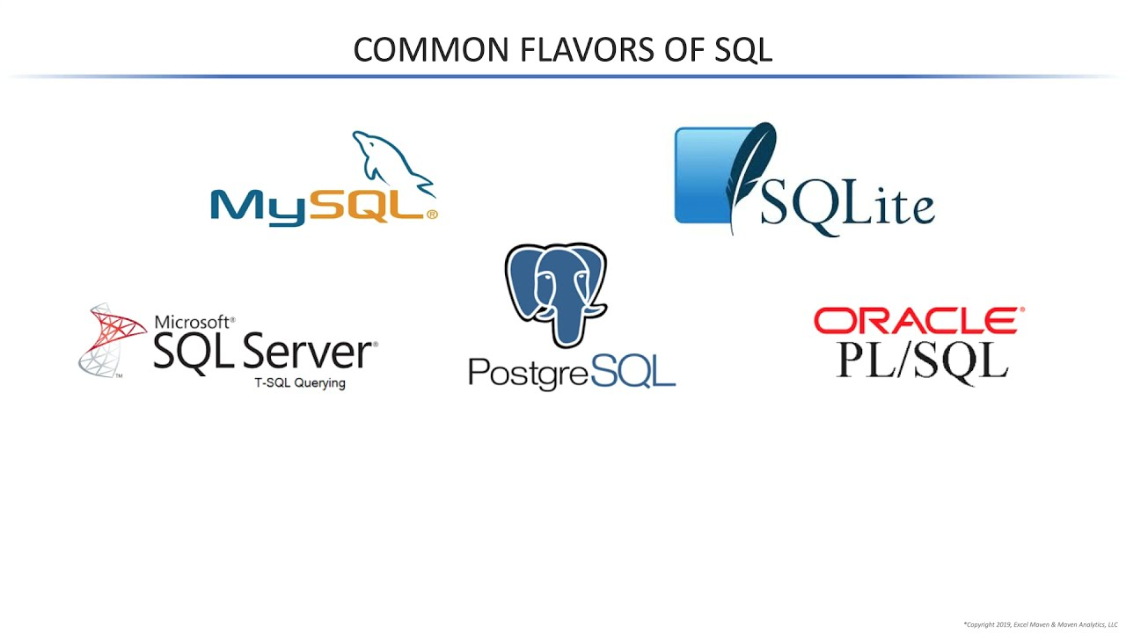
Relational Databases in AI/ML
Well-suited for structured data like user profiles, billing, and transactional logs.
SQL for querying and transformations; integrates with pandas, Spark, etc.
ACID compliance ensures reliability.
Examples: MySQL, PostgreSQL.
Notes:
Financial institutions rely heavily on relational databases for compliance-critical transactional data feeding ML models for fraud detection.

Slide 11
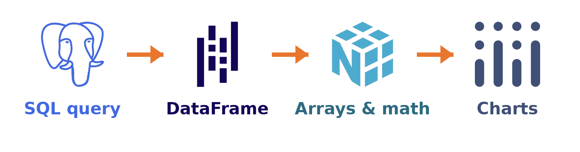
Refresher: From Database to DataFrame
Query in SQL, analyze in Python.
Pull only the rows you need, then work in memory.
Same data, three views: table, DataFrame, array.

Slide 12
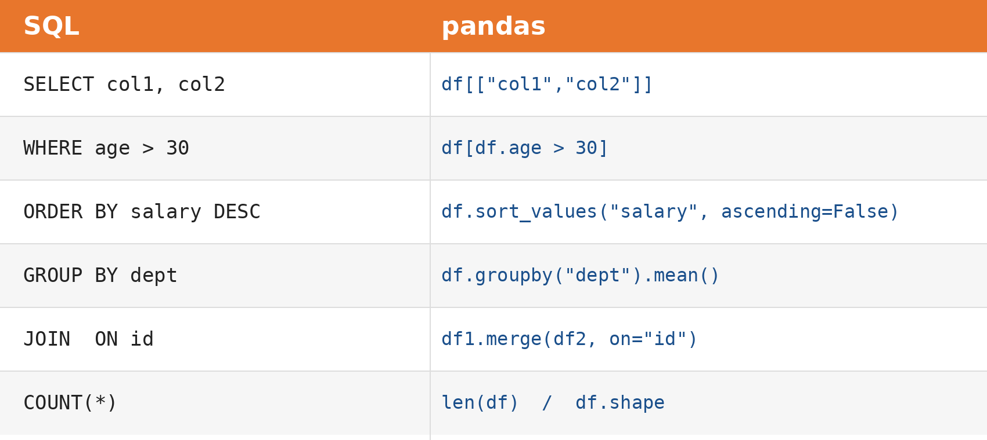
SQL to pandas Cheat Sheet
Same ideas, different syntax.

Slide 13
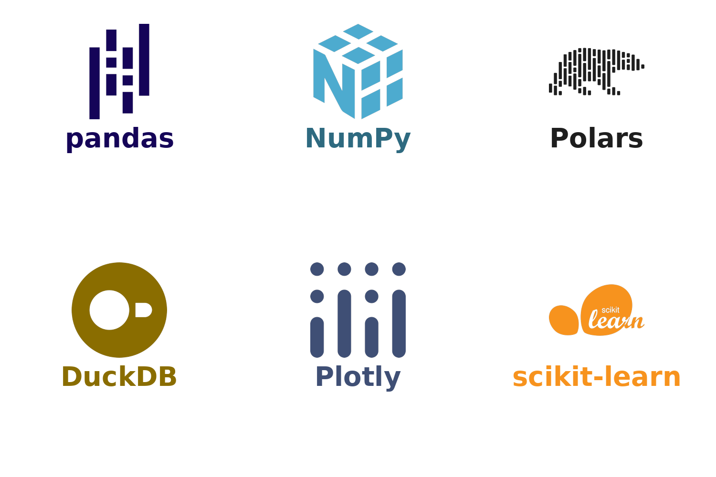
Your Data Toolkit
pandas + NumPy for cleaning and math.
Polars / DuckDB when data outgrows pandas.
Plotly for charts.
scikit-learn comes next week.

Slide 14
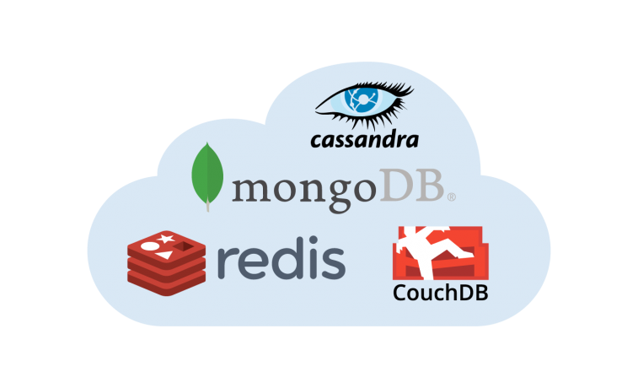
NoSQL Databases in AI/ML
Designed for unstructured/semi-structured data.
Flexible schemas and horizontal scalability.
Key-Value, Document, Column, Graph models.
Examples:
MongoDB (Document)
Cassandra (Column)
Redis (Key-Value)
Notes:
Instagram uses Cassandra to store billions of user actions per day, later feeding ML systems for recommendations and abuse detection.

Slide 15
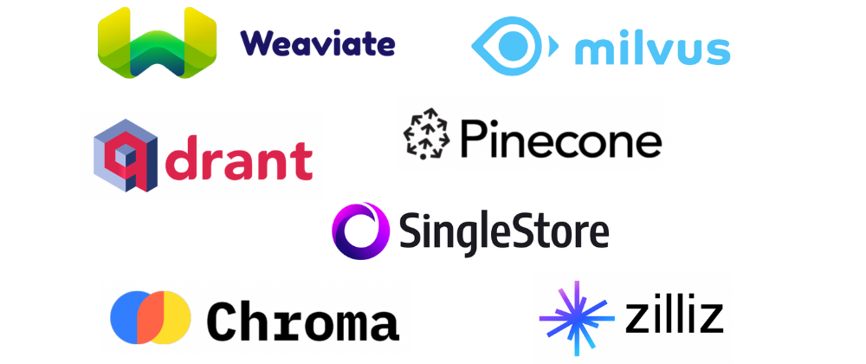
Introduction to Vector Databases
Store high-dimensional vector embeddings created by ML models.
Crucial for AI/ML tasks like semantic search, recommendation, and similarity matching.
Optimized for fast nearest neighbor (ANN) search.
Examples: Pinecone, Weaviate, Milvus, Vespa.
Notes:
OpenAI ecosystem: Developers use Pinecone or Weaviate to store embeddings from GPT models for semantic search and chatbots.

Slide 16
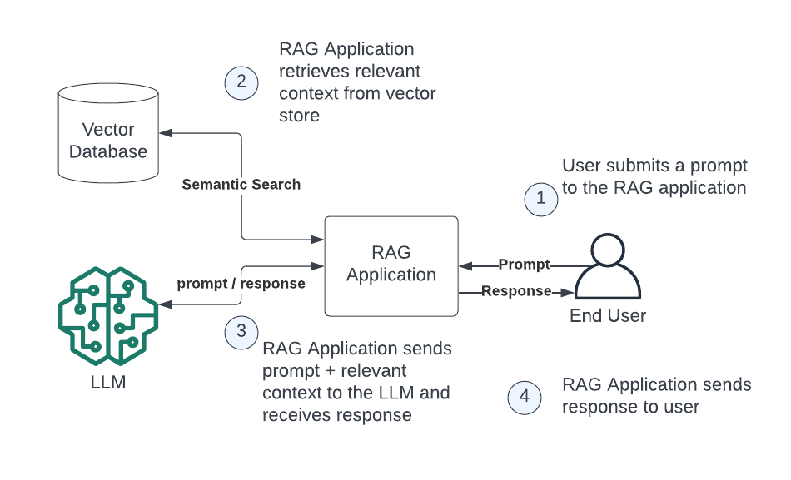

Slide 17
How Vector Databases Work
Convert Data to Embeddings
ML models (BERT, CLIP, OpenAI) turn text, images, audio into high-dimensional vectors (embeddings).
Store Vectors with Metadata
Vector DB keeps embeddings plus IDs, categories, timestamps for filtering and organization.
Index for Fast Search
Uses Approximate Nearest Neighbor (ANN) methods like HNSW, IVF, PQ to quickly find similar vectors at scale.
Query and Retrieve
A query is converted into an embedding, and the DB returns the closest matches using similarity metrics (cosine, dot product, Euclidean).
Hybrid Search
Combines vector similarity with filters or keywords (e.g. “similar products only in category X”).
Notes:
Approximate Nearest Neighbor (ANN)
HNSW (Hierarchical Navigable Small World Graph): builds a navigable graph of vectors for fast traversal.
IVF (Inverted File): clusters vectors into partitions to search fewer groups.
PQ (Product Quantization): compresses vectors to save memory and speed up search.
What is Faiss?

Slide 18
Use Cases of Vector Databases
Natural Language Processing: semantic search, question answering.
Image/Video Retrieval: similarity search on embeddings.
Recommendation Engines: personalized product or content suggestions.
Fraud Detection: anomaly detection in vector space.

Slide 19
Industry Trends and Best Practices
Shift to cloud-native, fully managed databases.
Real-time analytics and streaming data processing.
Rising adoption of vector and graph databases in AI/ML.
Best practice: start with the use case, then choose the database.
Polyglot persistence: combine multiple databases (SQL + NoSQL + Vector).

Slide 20
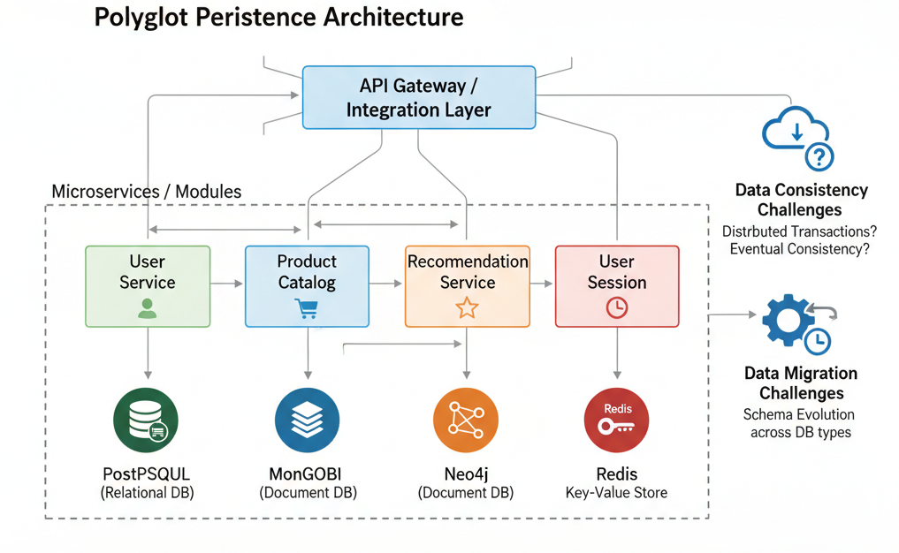

Slide 21
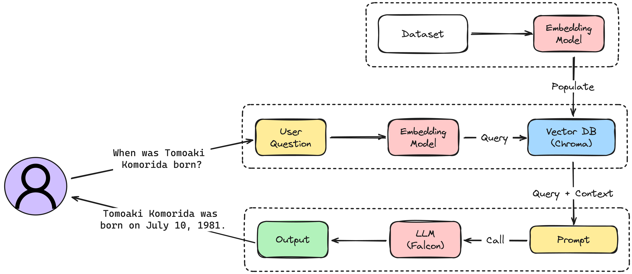

Slide 22
Database Architecture in AI/ML Pipelines
Raw data (logs, images, text) → Stored in object storage or NoSQL.
Structured data → Stored in RDBMS.
Feature store → A specialized DB (Feast, Redis, BigQuery).
Embeddings → Stored in vector DB (Milvus, Pinecone).
Search layer → Elasticsearch for hybrid keyword + semantic.

Slide 23


